Slide 1
Use of spatial analytical approaches to identify ongoing HIV micro-epidemics in rural South Africa
Frank Tanser
Faculty Member, Africa Health Research Institute (AHRI)
Research Professor, College of Health Sciences, University of KwaZulu-Natal
Honorary Professor, Institute of Epidemiology and Health Care, UCL
Royal Society Newton Advanced Fellow

Slide 2
Outline
Introduction
HIV micro-epidemics
Population viral load
Geography of transmission
Design of an intervention
Notes:
First present an overview
Then present a few examples of research around micro-epidemics that I think exemplify the types of analyses that are possible to answer really big questions in HIV.
Talk about some plans going forward

Slide 3
Global ART scale-up
MODELLING RESULTS
4 million people on ART in South Africa in 2017
GBD HIV Collaborators
Lancet HIV 2017

Slide 4
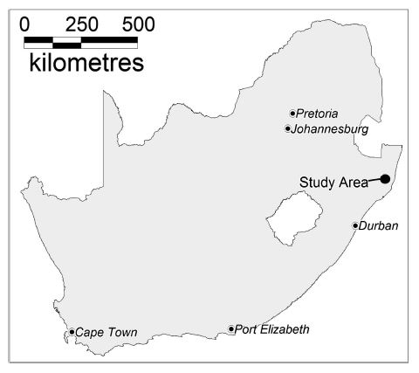
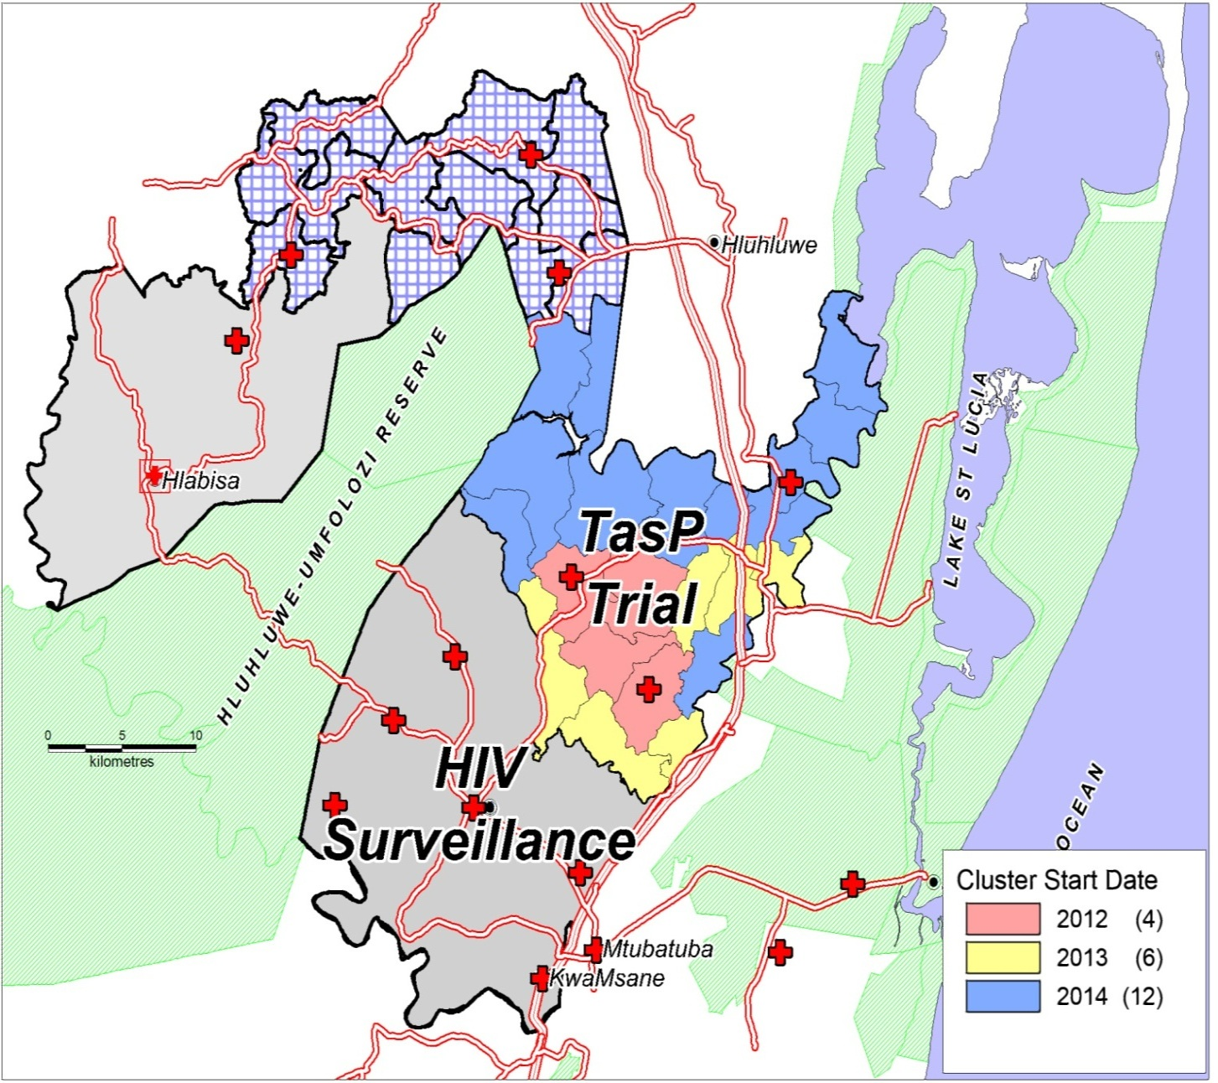
Study Location
N=90,000 (All ages)
Notes:
Adult HIV prevalence 29%
High levels of unemployment and poverty
Zulu-speaking population
Former homeland under apartheid

Slide 5
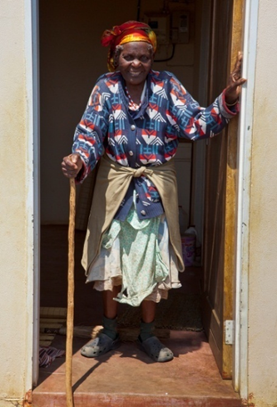
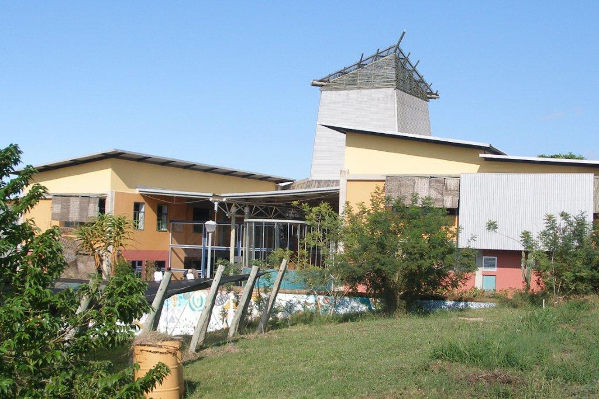
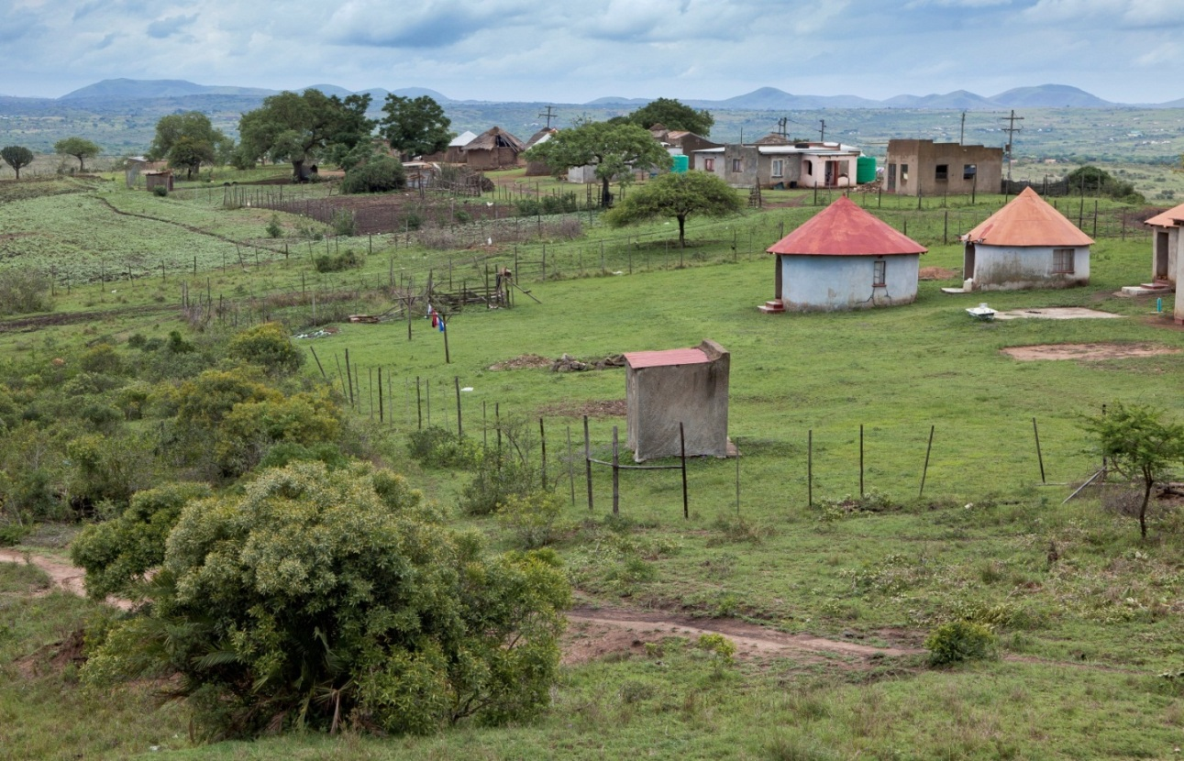
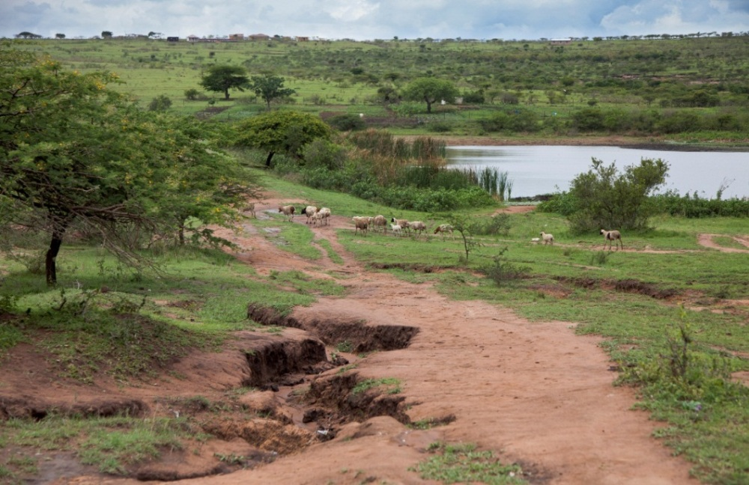
Setting
Africa Centre for Health and Population Studies

Slide 6
Population-level impact of increasing coverage of ART
90%
90%
90%
Diagnosed
On treatment
Virally supressed
Overarching question:
How can we interrupt HIV transmission?
Bor, Newell, Herbst and Bärnighausen, Science 2013
Key questions:
1. What is the best overall combination prevention approach?
2. Where should we target?
3. Who should we target?
Tanser F, Bärnighausen T, Grapsa E, Zaidi J, Newell ML. Science 2013
Notes:
Intro
- Profound impact
Panel 1
Coupled with this, exciting
Incredibly rich data
80,000 person-years
Make powerful statistical inference
Fully integrated into GIS, Kobus GRANULARITY
Panel 2
- The incredible opportunity here is
- And as the world moves to implement these programmatic targets we will be extremely well placed to measure the resultant impacts in the very “epicentre” of the epidemic - KZN
Panel 3
BUT why in this era of ART are we still having such high incidence?
Use this incredibly rich resource to answer:

Slide 7
Outline
Introduction
HIV micro-epidemics
Population viral load
Geography of transmission
Design of an intervention
Notes:
First present an overview
Then present on examples of research that I think exemplify the types of analyses that are possible at the Africa Centre to answer really big questions.
Talk about some plans going forward

Slide 8
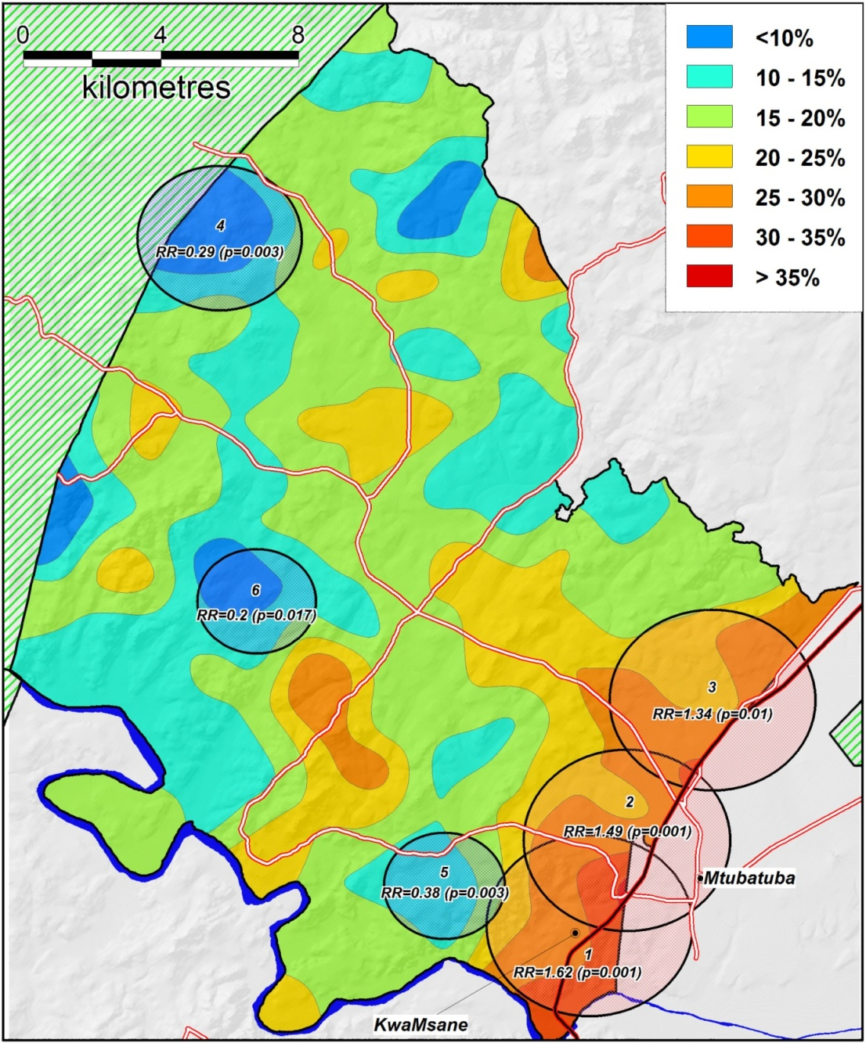
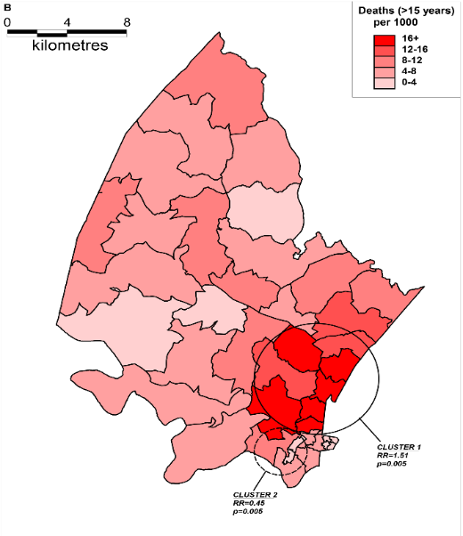
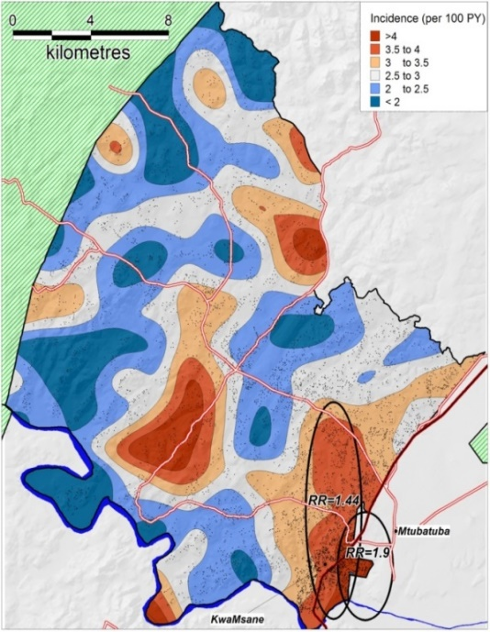
Exploiting heterogeneity in risk is key for epidemic reversal
Tanser et al IJE; 2009
Nomosha et al PloS One. 2012
Tanser et al CROI. Boston, MA; 2011
Notes:
Intro
- Extraordinarily heterogeneous.
- Real opportunity I believe to exploit those heterogeneities for epidemic control by intervening in the most vulnerable populations.
These maps were generated using a Gaussian Kernel approach of radius 3km to produce an underlying surface that is sensitive to local variation whilst at the same time being robust to the effects of random noise.
Superimposed on the maps are the Kulldorrf spatial clusters implemented within the Satscan programme. Identifies clusters unlikely to have arisen by chance
- help one appreciate the “Tyranny of averages”
radical shift in thinking - Anathma! When I first arrived at the then Africa Centre in 1997
Top map – these populations have high numbers of lifetime partners, highly mobile individuals

Slide 9
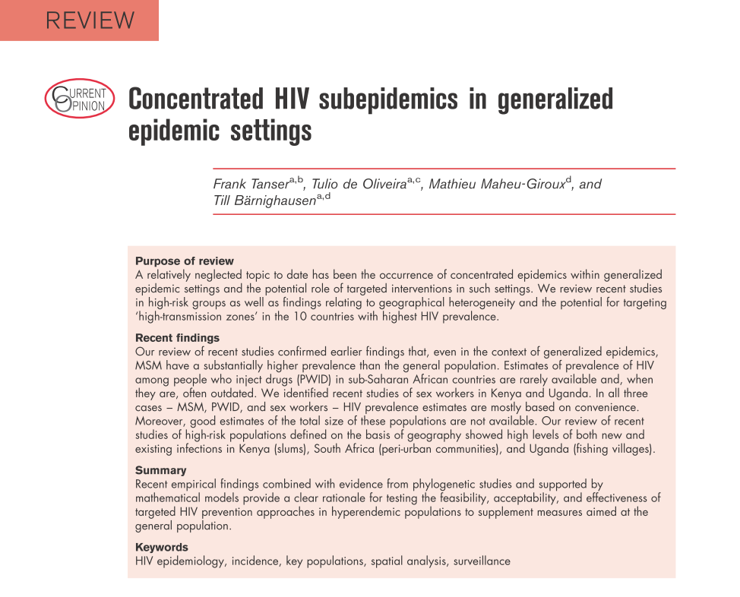
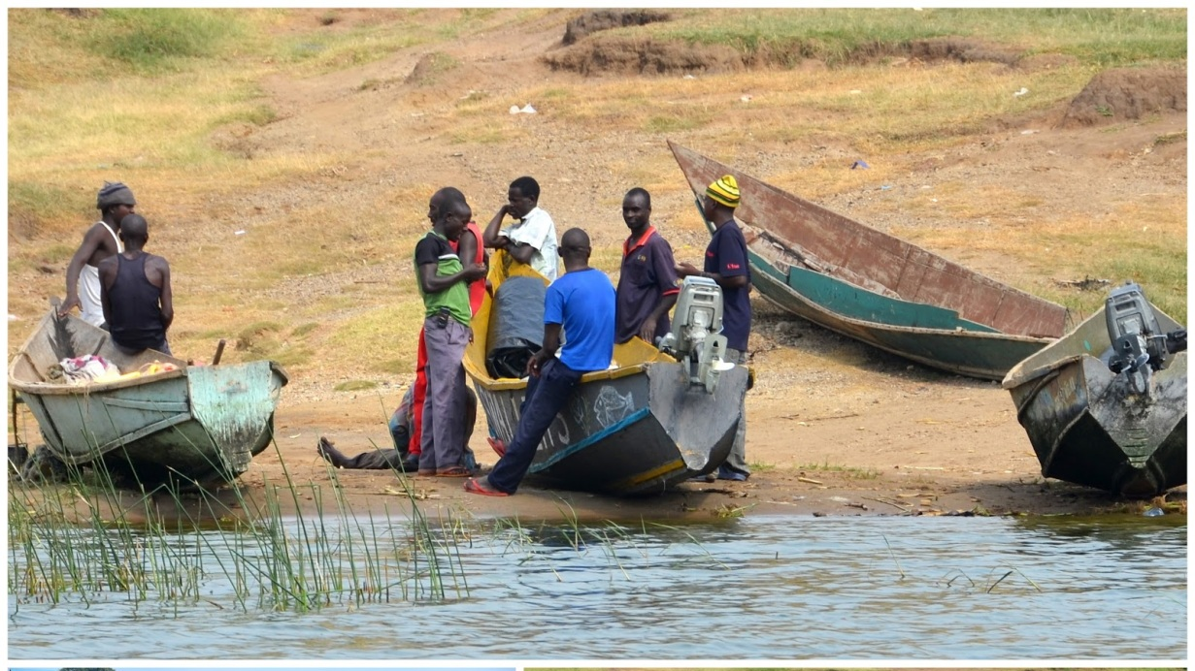
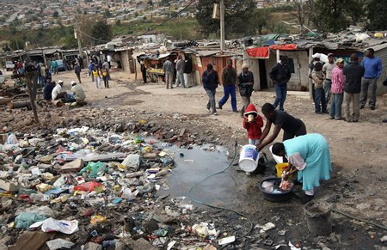

Slide 10
Gender differentials in HIV incidence and viral load
Female HIV incidence
Male viral load
Notes:
Intro
- Extraordinarily heterogeneous.
- Real opportunity I believe to exploit those heterogeneities for epidemic control by intervening in the most vulnerable populations.
Panel 1
greatest challenges remains in the high incidence in young females
Jane and Maryam
- Young men - Tulio
Panel 2
- help one appreciate the “Tyranny of averages”
Another areas where we have had substantial impact on policy
UNAIDS continue to us for leadership in this area
radical shift in thinking - Anathma!
Top map
Bottom map – shows some of the early results from the population viral work
- 25% of the entire population has unsuppressed viral load! 1 out or 4 viremic for HIV!
- When one is confronted with statistics like that one begins to get a sense of the magnitude of the problem we are dealing with!
Panel 3
- The question then arises; what if these areas were the engines of the epidemic?
Could we do HIV control differently? More analogous to a small pox – ring vaccination type approach.
Here is some early phylogenetic data in support of this intriguing hypothesis
Where else in the world would you have data like this to answer such an important question! But the Unified Institute. Really incredible
Submitting this to Nature
“Panel 4”
- I think it is really important we take a multi-disciplinary approach..
- clear synergies across all the programmes and you will hear other talks on these aspects over the course of the visit.

Slide 11
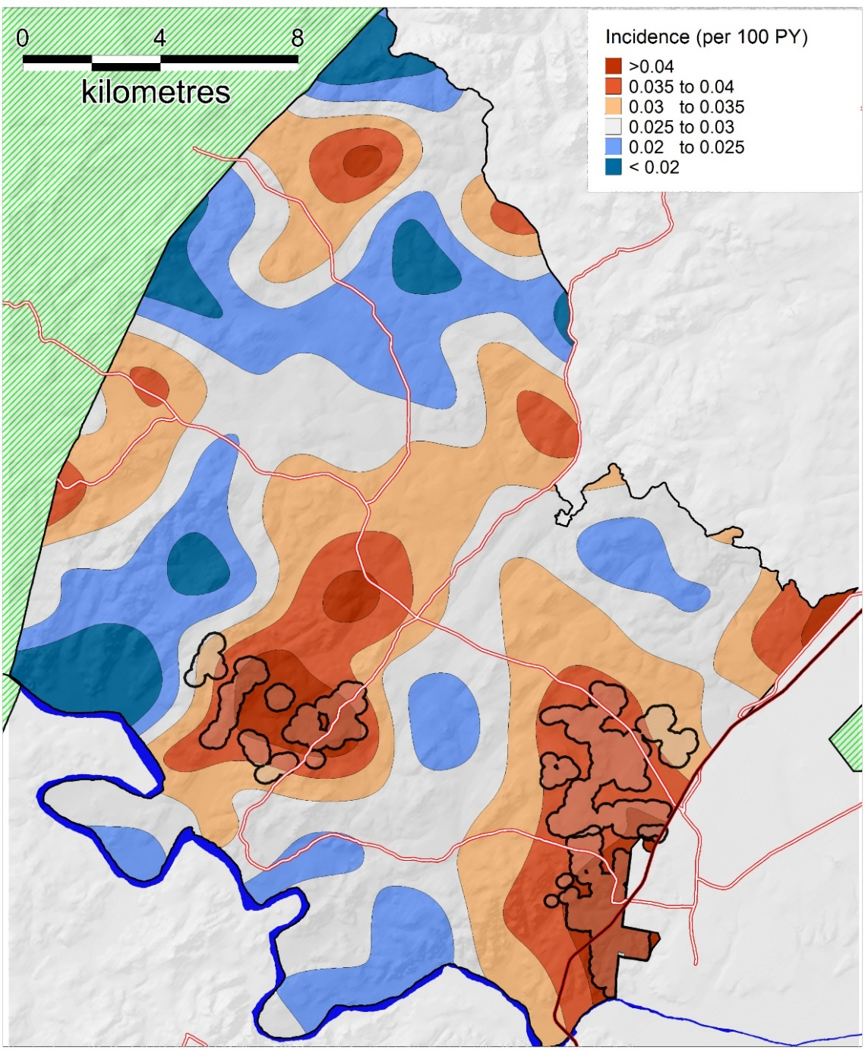
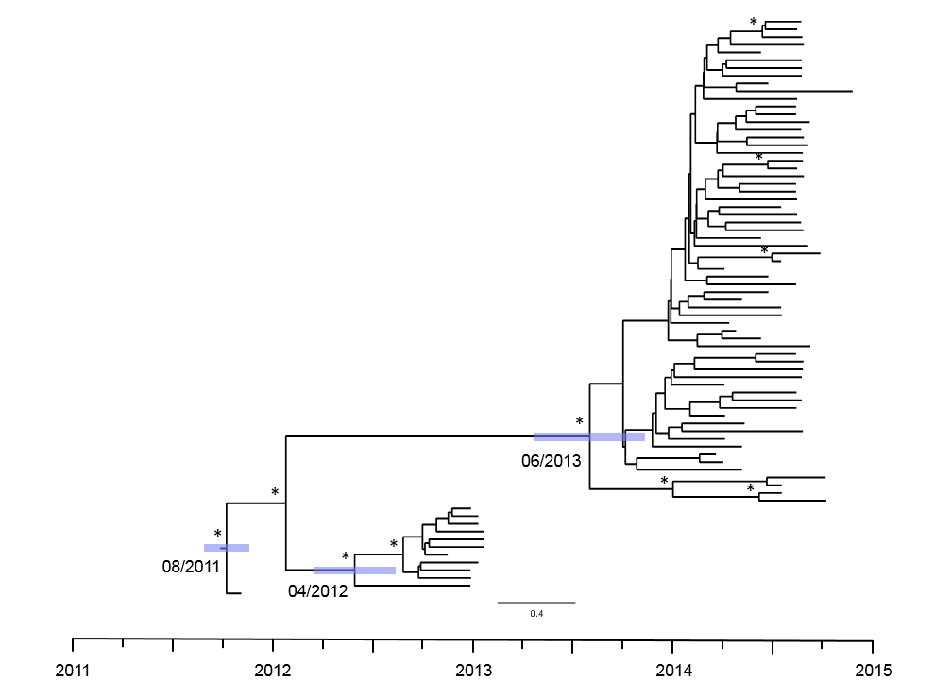
‘Corridors of transmission’
Q2. Where should we target?
Dated phylogeny of cluster
KEY:
Date = Mean origin of node date
= 95% higher probability density for emergence event
* Posterior Probability (branch support) > 0.90
Single ancestral source
Cluster 2 RR=1.57 p=0.015
Cluster 3 RR=2.27 p=0.020
Cluster1 RR=1.59, p=0.001
Identification of ‘corridors of transmission’: A case for a shift towards a targeted intervention strategy Tanser et al. IJE (2018)
Coltart et al CROI (2018)
Notes:
Study revealed clear ‘corridors of transmission’
The most surprising aspect of this recent work has been the rapid emergence
Incidence of >10% per year.
But these clusters of high incidence with high levels of viral non-suppression really underpins the HITS trial
Rapid socioeconomic changes, such as those induced by
mines and other industrial developments, that bring people and money to poor areas may have unintended health
consequences. We propose that flexible HIV prevention and sexual health services are required to rapidly respond to such events
For the first time to our knowledge, we applied
Tango’s flexibly shaped spatial scan statistic
28
(implemented
in FleXScan software
29
) to identify micro-geographical clus-
tering of new HIV infections. Spatial scan statistics are de-
signed to detect a local excess of events and to test whether
such identified excess could reasonably have occurred by
chance.
30
Most dis-ease or health outcome events are not likely to conform to a

Slide 12
Outline
Introduction
HIV micro-epidemics
Population viral load
Geography of transmission
Design of an intervention
Notes:
First present an overview
Then present on examples of research that I think exemplify the types of analyses that are possible at the Africa Centre to answer really big questions.
Talk about some plans going forward

Slide 13
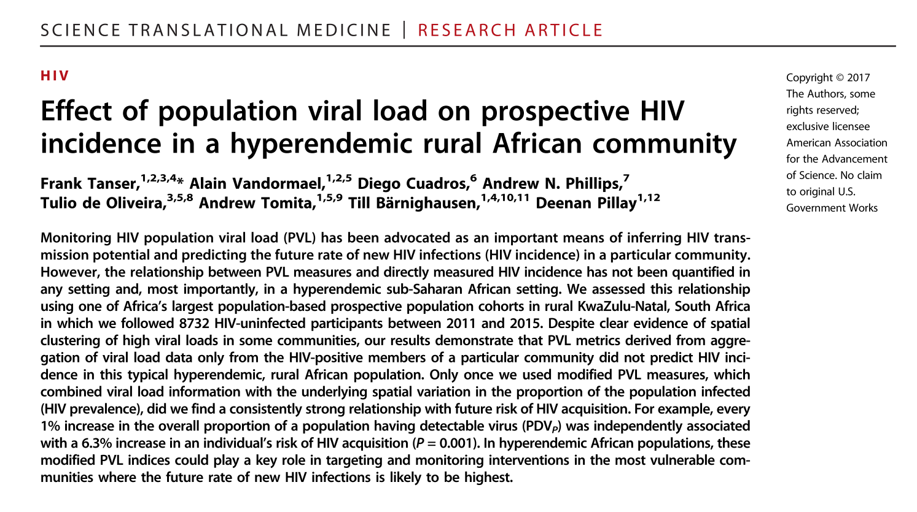
Notes:
Introduction: Population viral load has the potential to provide a very sensitive finger on the pulse of the epidemic.
Problem: There has never been a quantification of the relationship between PVL and directly-measured HIV incidence.
Results: Despite clear evidence of spatial clustering of high viral loads, there was no relationship between the advocated population viral load measures and prospective HIV incidence
- Every 1% increase in the PPDV was associated with a 6.3% increase in an individual’s risk of acquisition of infection
- When one is confronted with statistics like that, one begins to get a real sense of the magnitude of the problem we are dealing with
- However, we demonstrate that population viral load indices that explicitly account for HIV prevalence have a clear relationship to prospective HIV incidence
Implication: Such indices could therefore play a key role in targeting prevention interventions to specific communities

Slide 14
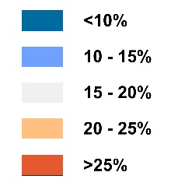
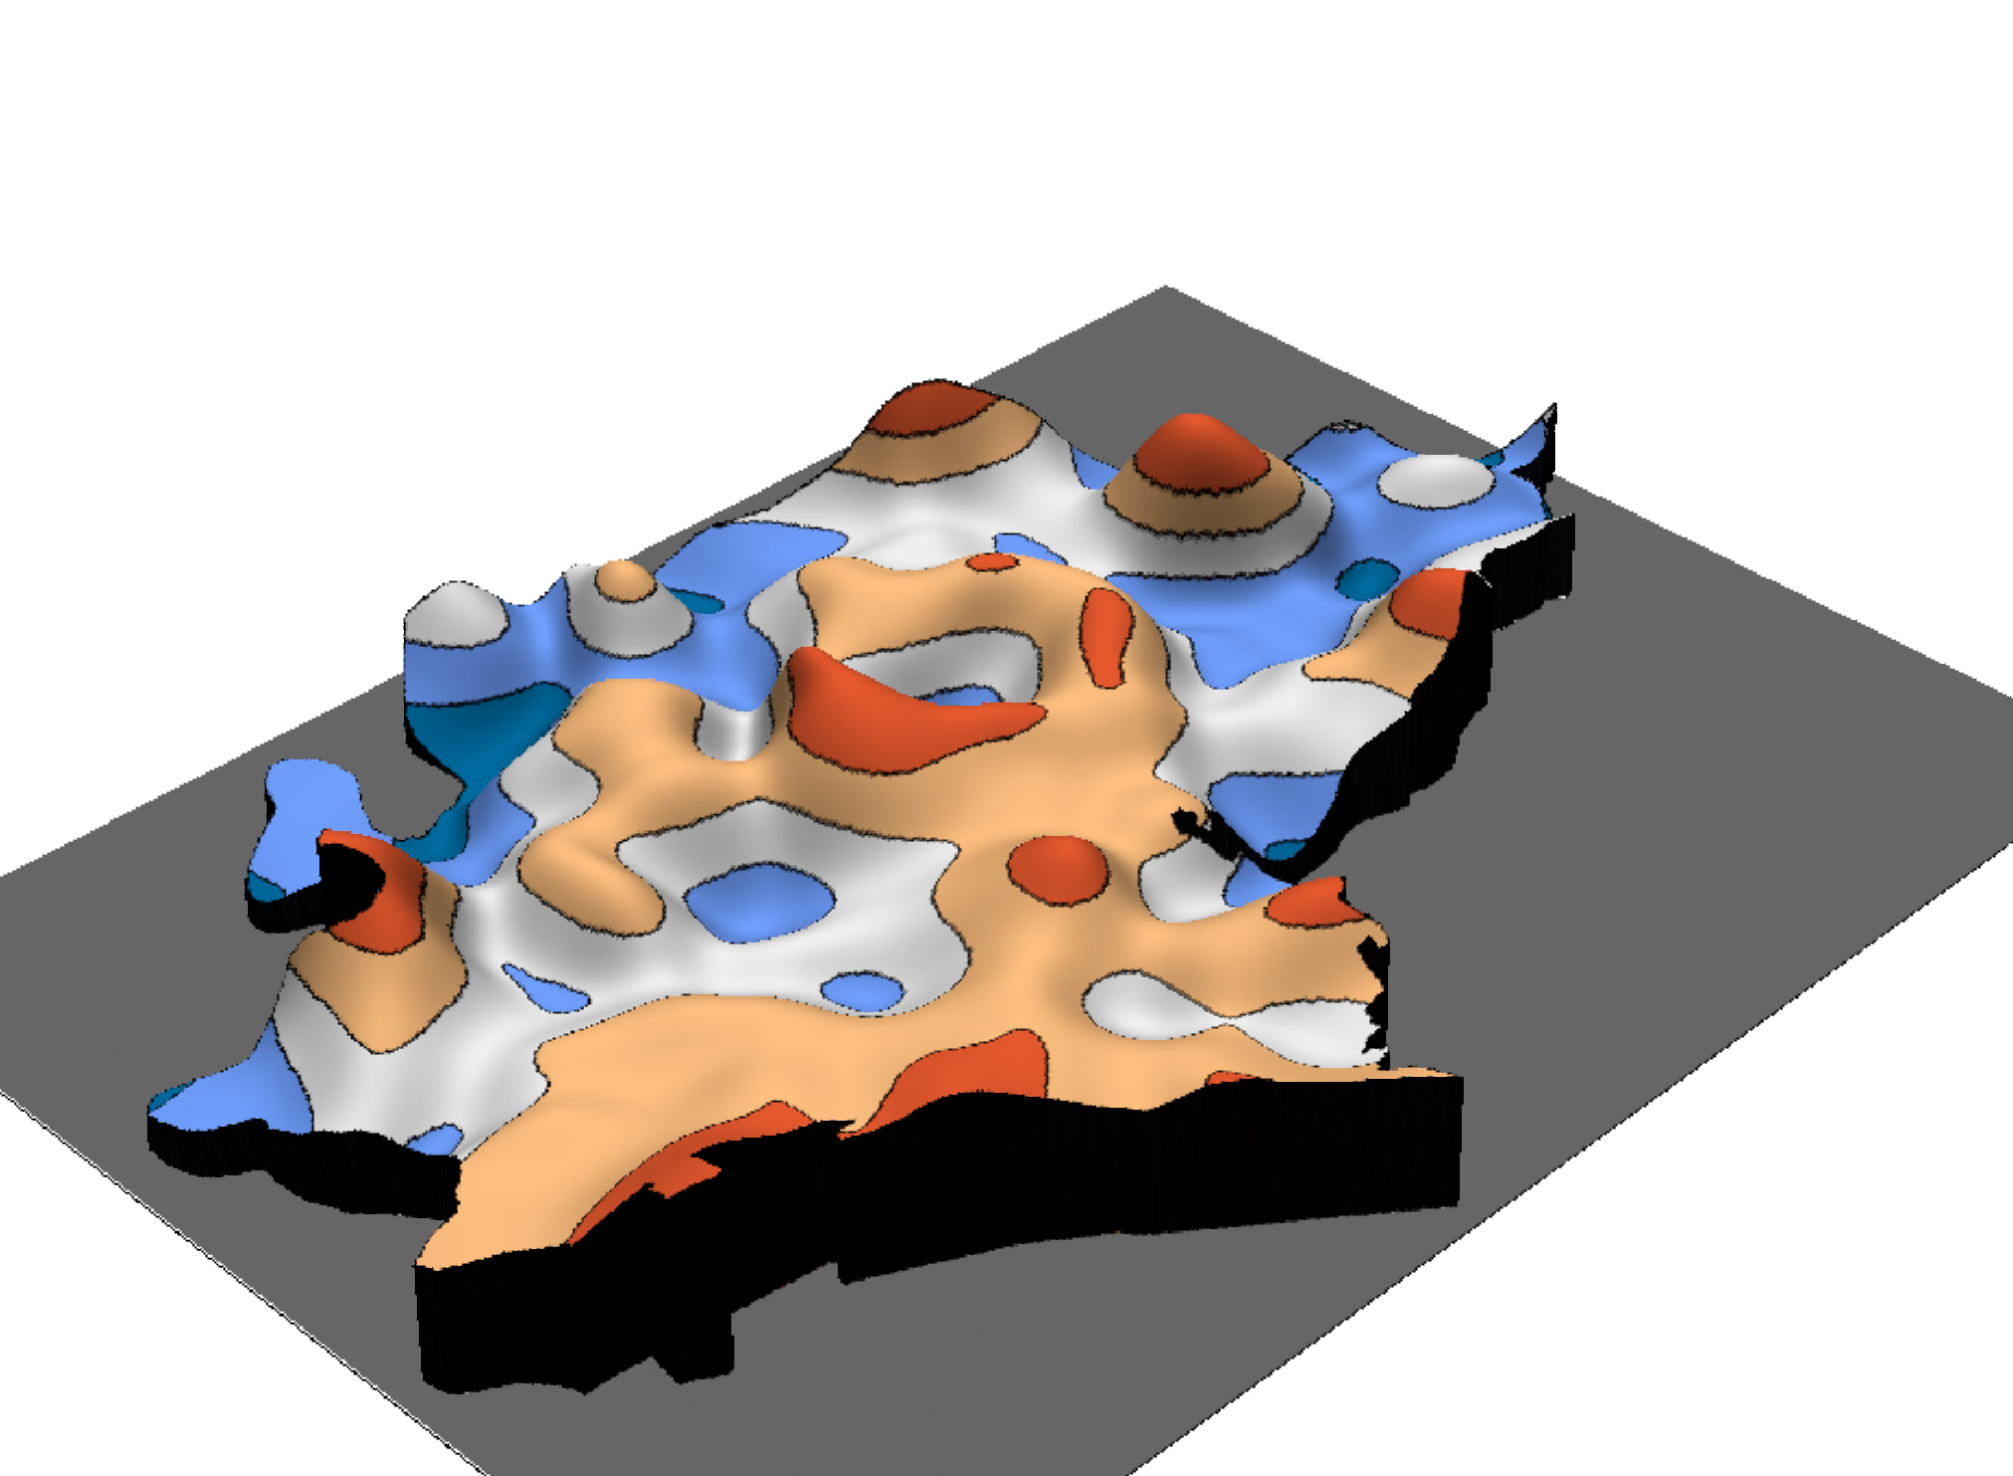
Ecological risk of HIV acquisition
Population Prevalence of
viremia
KwaMsane
Township
HIV incidence (per 100 PY)
Notes:
Bottom map – shows some of the results from the population viral work accepted for publication in Science Translational Medicine
- 25% of the entire population has unsuppressed viral load! 1 out or 4 viremic for HIV!
When one is confronted with statistics like that one begins to get a sense of the magnitude of the problem we are dealing with!
However, we demonstrate that population viral load indices that explicitly account for HIV prevalence have a clear relationship to prospective HIV incidence
Implication: Such indices could therefore play a key role in targeting prevention interventions to most-vulnerable communities
But these clusters of high incidence with high levels of viral non-suppression really underpins the HITS trial

Slide 15
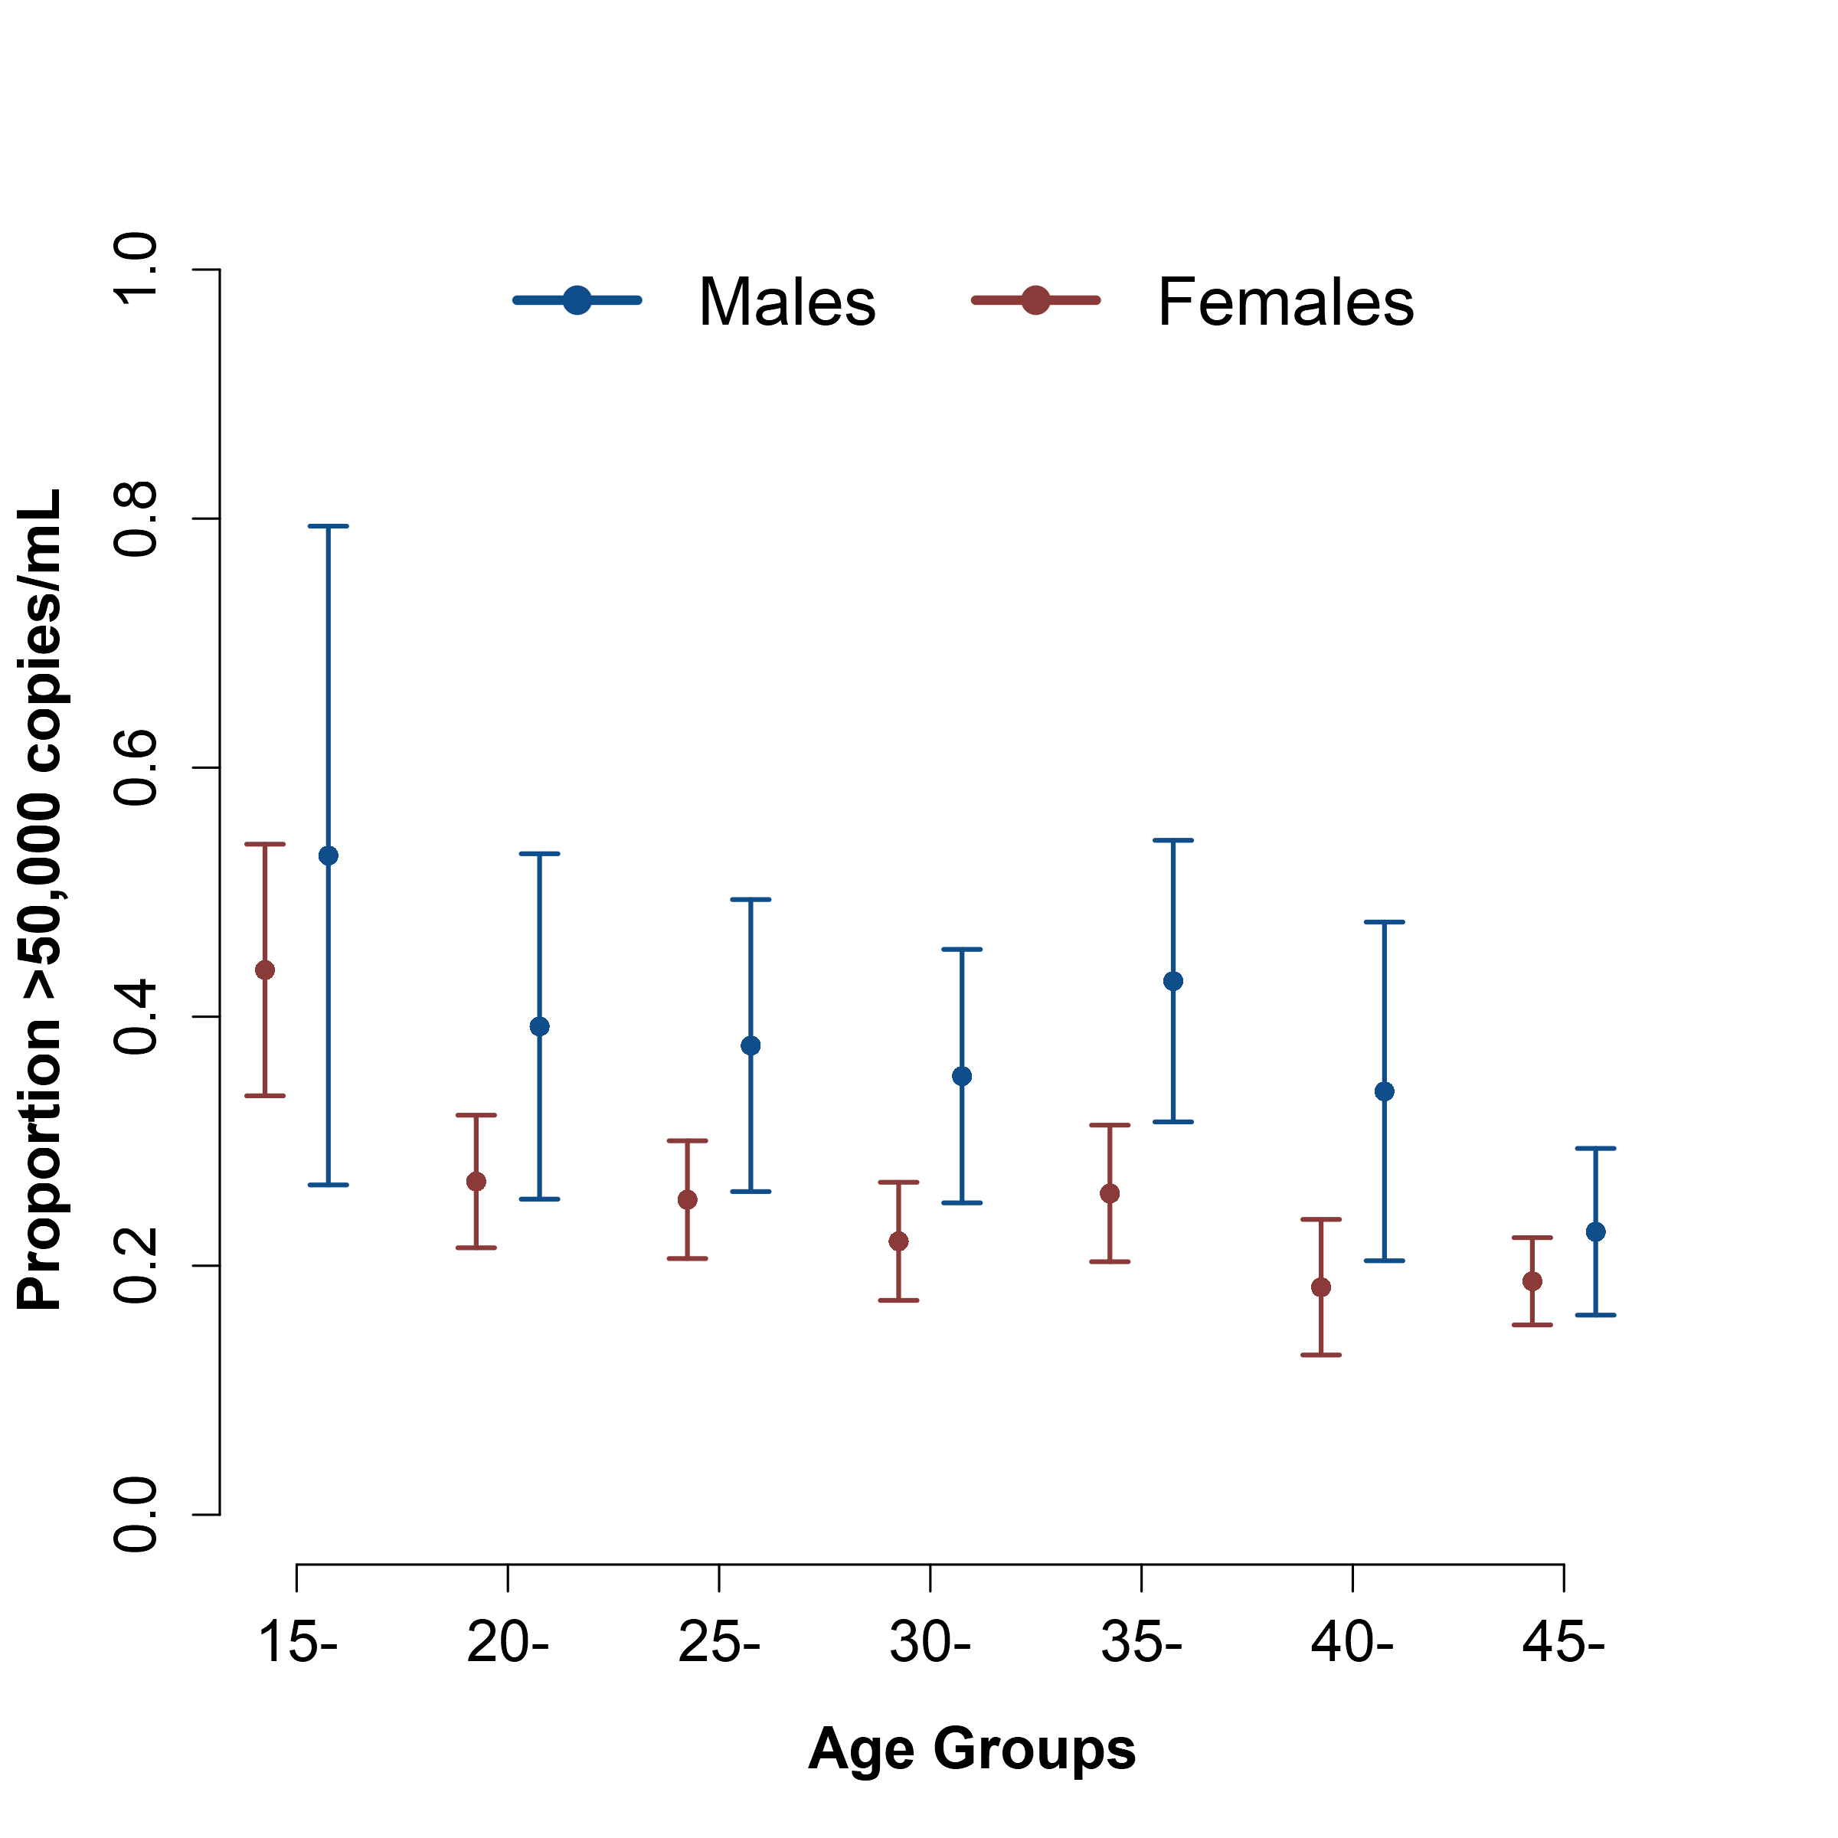
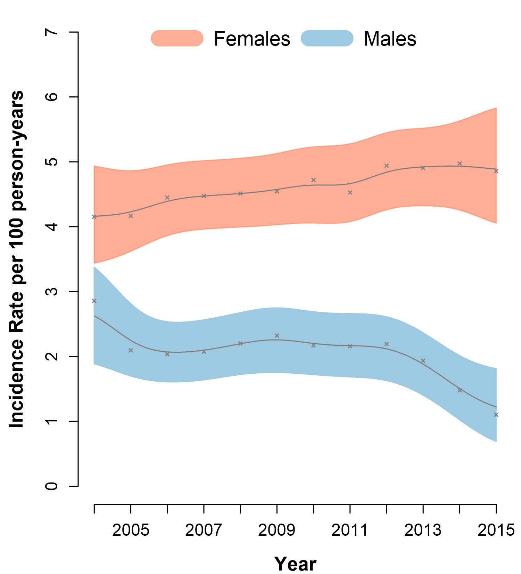
Population viral load patterns
Q1. Best combination approach
Vandormael A, et al A sharp decline in population-level male HIV incidence following rapid ART scale-up in rural KwaZulu-Natal, South Africa (2004–2015). CROI Oral 2018.
Population viral load and HIV incidence Tanser et al. STM (2017)
Notes:
Featured in the UNAIDS 2018 report
From the paper in STM we see that at a population level, viral load is higher in men
Many women are put onto treatment when pregnant
Consistent with a higher uptake of ART in females and an increase in circumcision, this exciting finding that there has been a decline in population-level male incidence
But concerning is the hint of an increase in females driven by the high force of infection in the young ages whose partners are not on ART
Which again motivates for finding ways to getting more men onto treatment

Slide 16
Outline
Introduction
HIV micro-epidemics
Population viral load
Geography of transmission
Design of an intervention
Notes:
First present an overview
Then present on examples of research that I think exemplify the types of analyses that are possible at the Africa Centre to answer really big questions.
Talk about some plans going forward

Slide 17
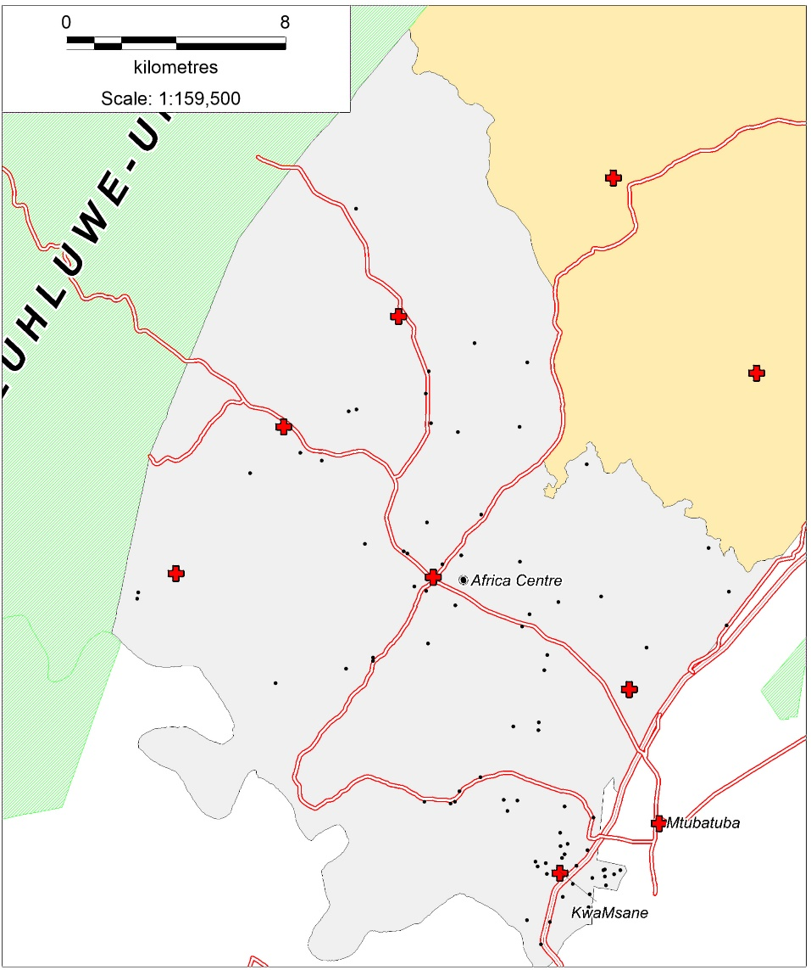
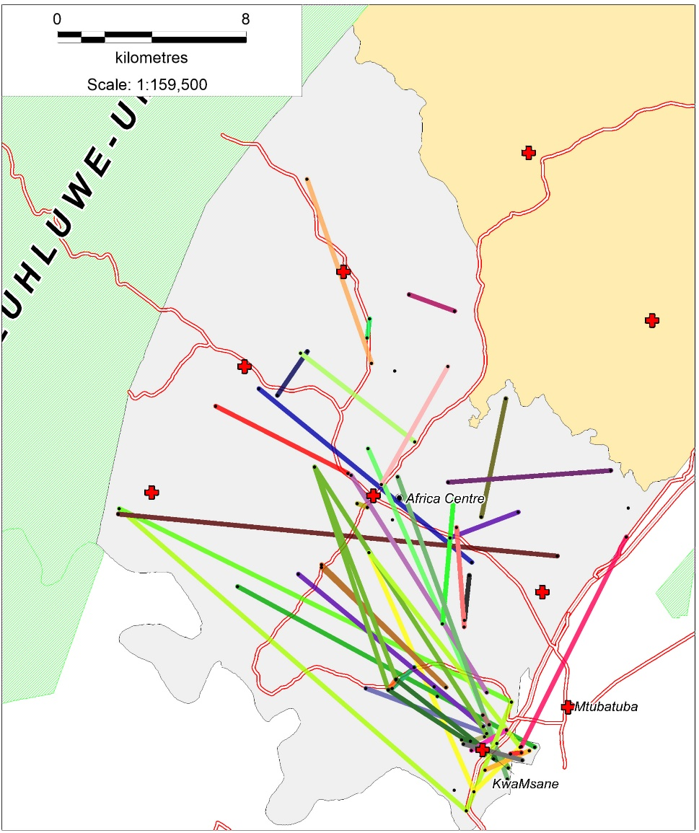
Geography of transmission
Cuadros D, Graff T, de Oliveira T, Bärnighausen T, Tanser F. Assessing the role of geographical HIV hot-spots in the spread of the epidemic. CROI 2018.
Intentional random spatial error introduced*
Notes:
Also appeared in 2018 UNAIDS report
- The question then arises; what if these areas were the engines of the epidemic?
Could we do HIV control differently? More analogous to a small pox – ring vaccination type approach.
Here is some early phylogenetic data in support of this intriguing hypothesis
In essence, can we find a way of TURNING OFF THE BROAD STREET PUMP!!!!
Submitting this to Nature

Slide 18
Outline
Introduction
HIV micro-epidemics
Population viral load
Geography of transmission
Design of an intervention
Notes:
Lots of intervention studies planned but I want to focus on one that I am particularly excited about and which directly pertains to the work that I presented this morning.

Slide 19
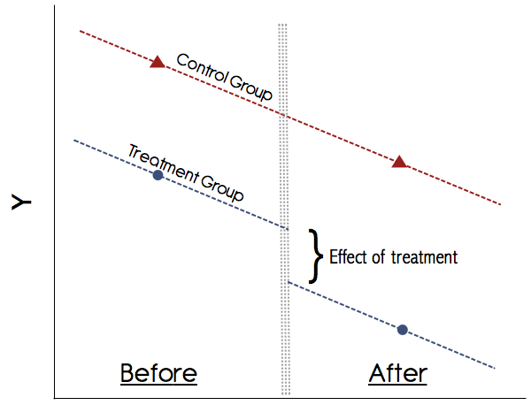
Bringing it all together: A Home-based intervention to test and start (HITS)
Q2. Where should we target?
Financial incentive to rapid test at home and link to HIV care
Gender sensitive counselling
Difference-in-differences analytical approach
Main outcomes - 25% drop in female incidence (15-30 years), male viral load & male HIV-related mortality
PIs: Tanser and Bärnighausen, with Wyke, Seeley, McGrath. (R01) Funding: NIH

Slide 20
Conclusion
Analyses suggest that exploiting heterogeneity in risk (geographical or otherwise) is key for epidemic reversal
Need to take a precision public health approach to ensure that “no one is left behind” - ie tailored interventions to reach the most vulnerable groups
Initial findings suggest that so-called ‘hot-spot’ communities are also playing a substantive role in re-seeding epidemics in other areas
Novel interventions targeting high-risk groups and geographies critical

Slide 21
Acknowledgements
Till Bärnighausen
Tulio de Oliveira
Andrew Philips
Adrian Dobra
Deenan Pillay
Adam Akullian

Slide 22
With thanks to the members of my group

